Slide 1

115.113 Lecture 3
Economics For Business

Slide 2
Introduction
Readings
Outline
Key words
14.1 to 14.2
14.5 to 14.8
Aggregate Demand function and multiplier model
The role of the Government
The effect of debt
Aggregate Demand
Fiscal policy
Multiplier
Government Debt

Slide 3
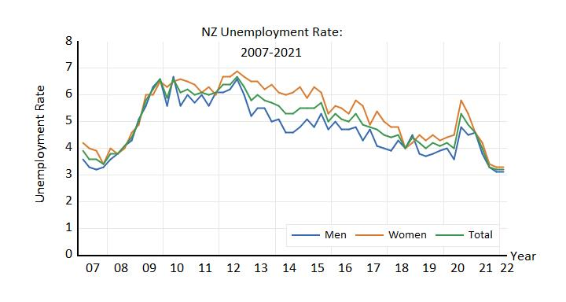
NZ Economy
Since early 2007 the Unemployment Rate has fluctuated.
What was associated with the visible surges?

Slide 4
INTRODUCTION
Aggregate Demand

Slide 5
Context
Sometimes the aggregate decisions of households and firms can destabilize the economy.
How can the government stabilize the economy?
Why might government policies be ineffective?
How can we model the link between output and unemployment?
Aggregate Demand (GDP) fluctuates due to consumption and investment decisions

Slide 6
Aggregate Demand
02.
Introducing the Multiplier

Slide 7
Aggregate Demand =
C + I + G + X - M
GDP (expenditure approach)

Slide 8
Consumption function
Autonomous consumption = the fixed amount one will spend, independent of income
Consumption that is dependent on income
Slope of consumption function = marginal propensity to consume
Aggregate consumption (C) has two parts

Slide 9
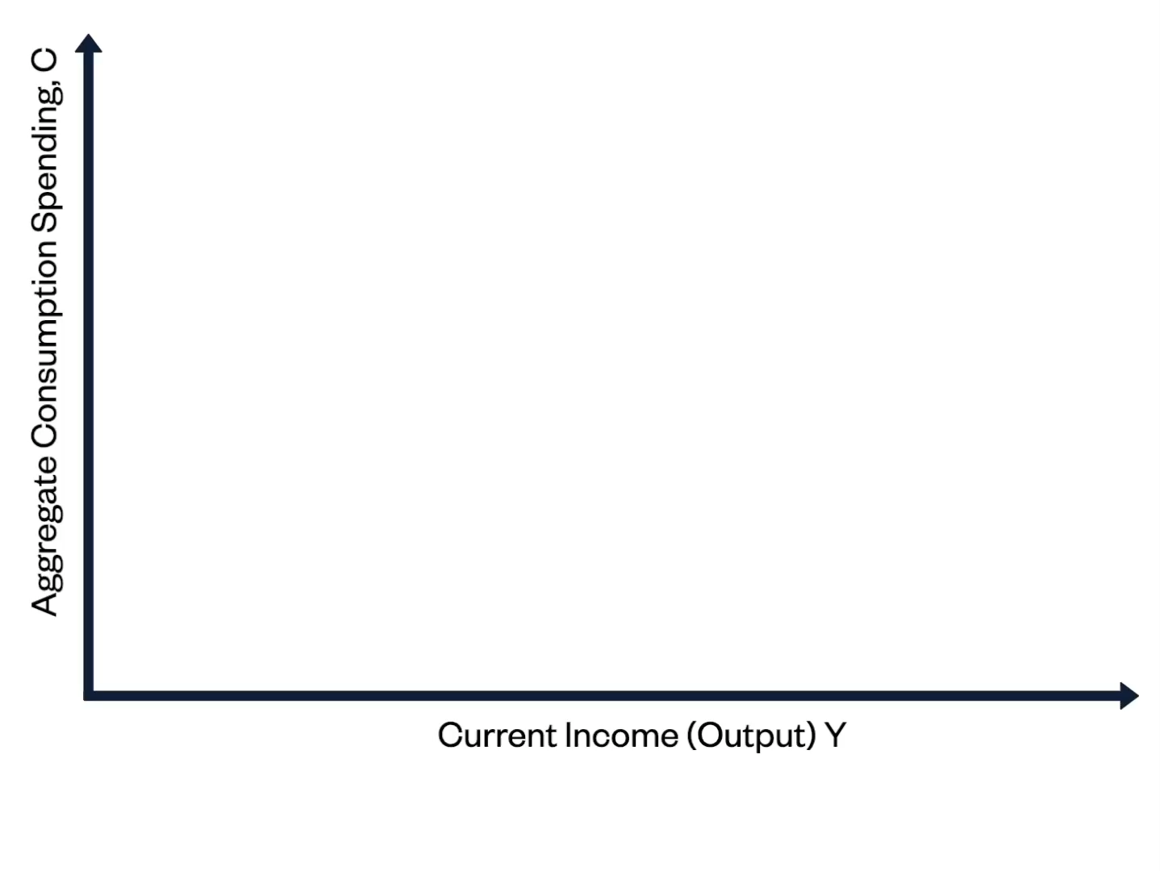
Consumption function
In this example, aggregate spending by households rises 60c for every dollar of income.
The other 40c are saved.

Slide 10
Consumption function
Poor households with credit constraints react a lot to variation in current income, so their MPC is large
Wealthy households, current income matters little for current consumption, so their MPC is small
Expectations about future income are reflected in autonomous consumption.
Marginal propensity to consume varies across people (and countries):

Slide 11
Expectations
If you expect your income or wealth to increase in future you
are willing to consume at a higher level now.
E.g. In housing booms people’s wealth can rise rapidly and they lift spending.
Durables or travel often popular
If you expect income to decrease in future you
Are willing to consume at a lower level
E.g. people who fear they will lose their jobs. They increase their savings.

Slide 12
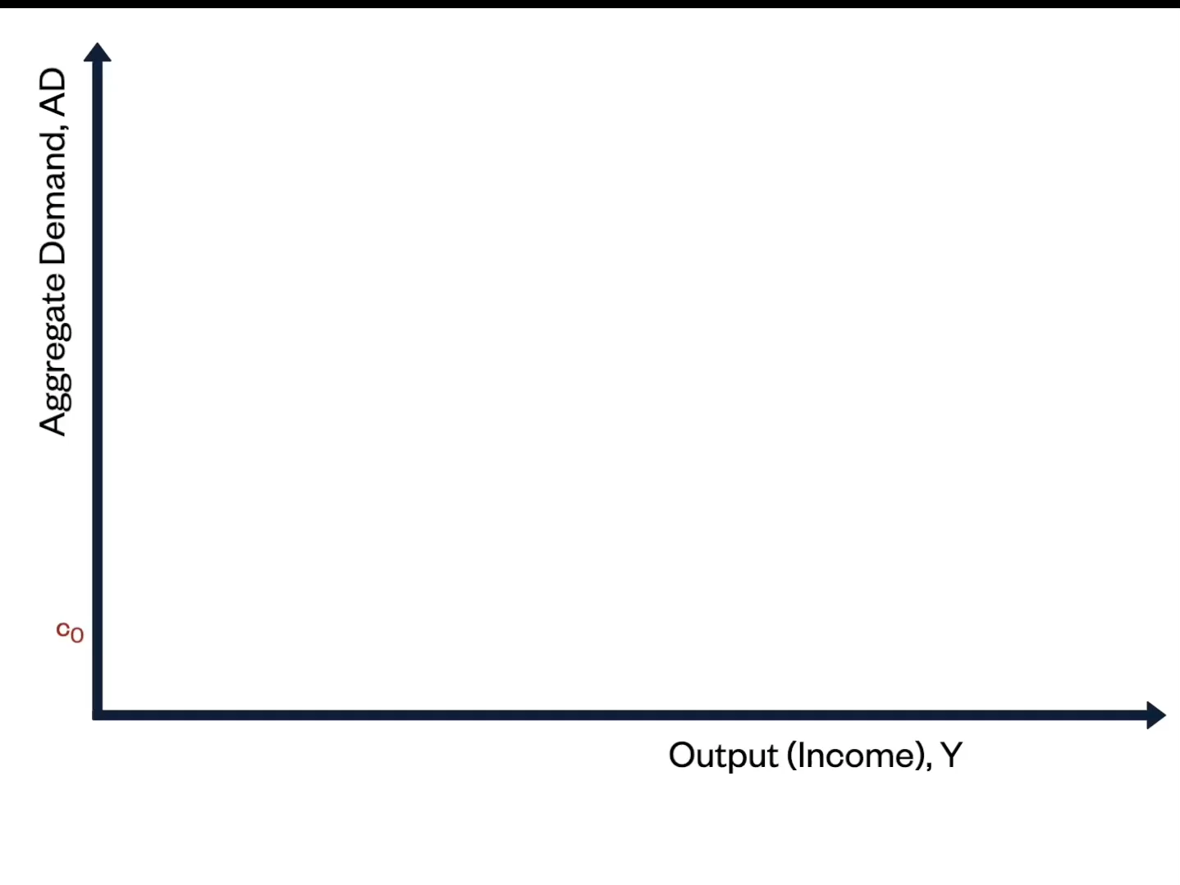
Model 1
In this simple model there is no Government or External Sector
Y = AD = C + I
Investment is independent of income

Slide 13
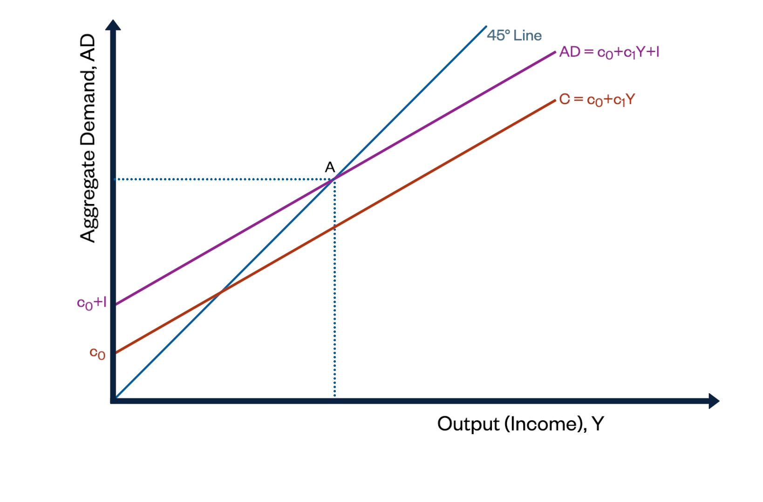
Model 1
The slope of the AD line <1 because the MPC is < 1.
The 45-degree line is shows where income equals spending.
The intersection of AD and 45°line (A) is goods market equilibrium

Slide 14
Disequilibrium Illustrated
Spending > Y
Aggregate Demand
Spending < Y
Y = Output = Income

Slide 15
Goods Market Equilibrium
What happens if economy is not in equilibrium?
Below 45° line AD < Y
Above 45° line AD > Y
If output > spending, firms notice inventories increasing. They reduce output.
If output < spending, firms notice their inventories are decreasing. They increase output.

Slide 16
Numerical Example
Y = C +I
  Y = C* + cY + I*
Y = 100 + 0.8Y + 200
  Y=0.8Y + 300
  Y – 0.8Y = 300
  (1-0.8)Y = 300
Y_{e} = 300/(1-0.8)
  Y_{e} = 300/(0.2)
  Y_{e} = 1500
Values marked with * are exogenous
The MPC is c
Factoring out the Y terms is important step.

Slide 17
The Multiplier
03.
How GDP responds to shocks

Slide 18
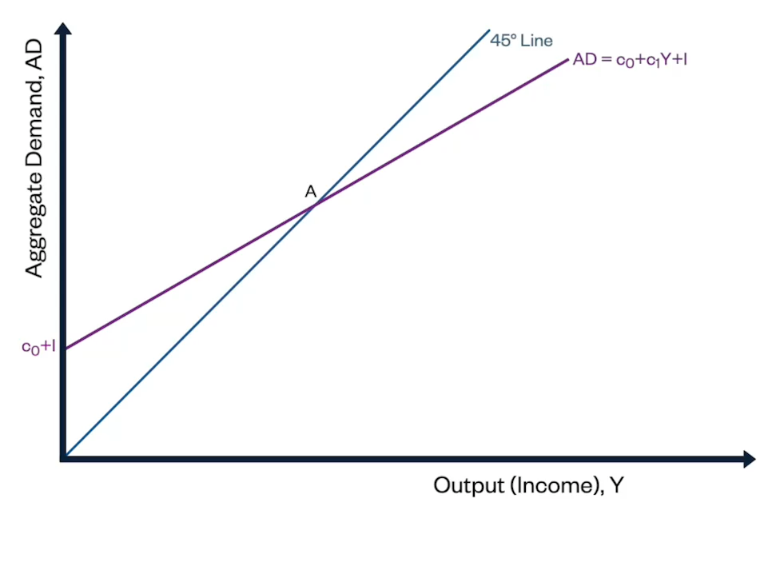
The Multiplier Process
We start at point A
Suppose I decreases by €1.5bn.
How much will Y change by?

Slide 19
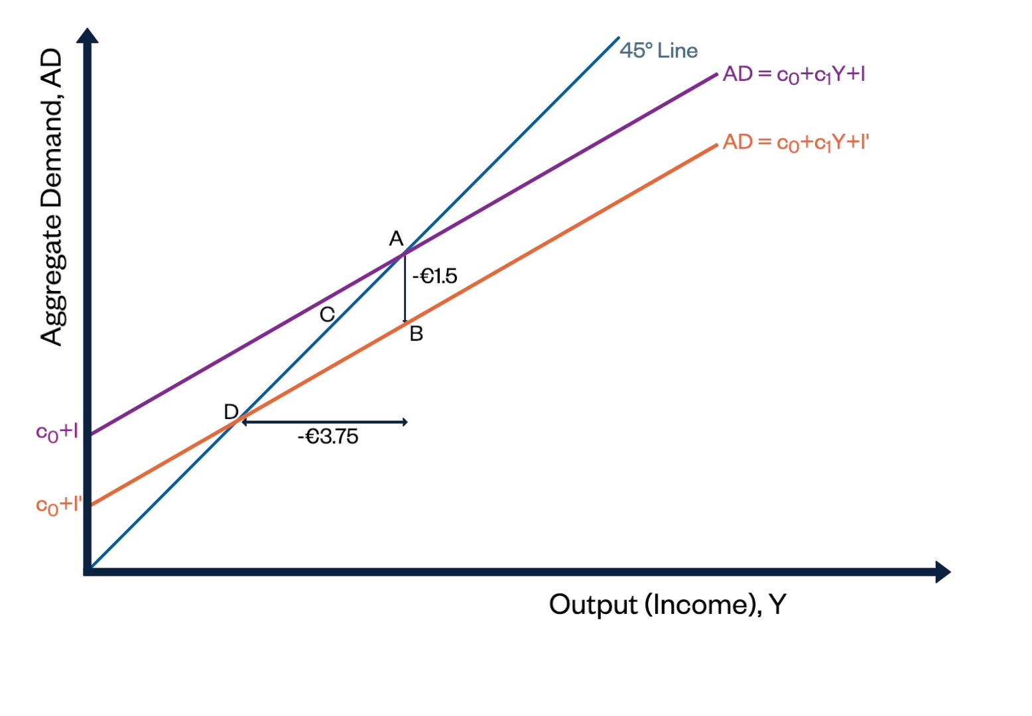
The Multiplier Process
As firm’s produce less, incomes (wages etc) are lower.
Spending drops.
Process continues until we reach D
A €1.5 bn fall in I leads to a €3.75 bn fall in Y

Slide 20
The multiplier effect
Expenditure, income, and output are in a circular flow
The multiplier represents the relative magnitude of this change.
multiplier = 1: the increase in GDP = the initial increase in spending
multiplier < 1: the total increase in GDP > the initial increase in spending
The total change in output can be greater than the initial change in aggregate demand.
The larger the MPC, the larger the multiplier!

Slide 21
Changes in consumption function
Consumption decisions can also shift the AD curve.
E.g. fall in house prices will be bad news for a household with a mortgage.
hence their autonomous consumption would fall.
They may choose to save more (precautionary saving)
Credit constraints and consumption smoothing is reflected in the slope of the AD curve and the size of the multiplier.

Slide 22
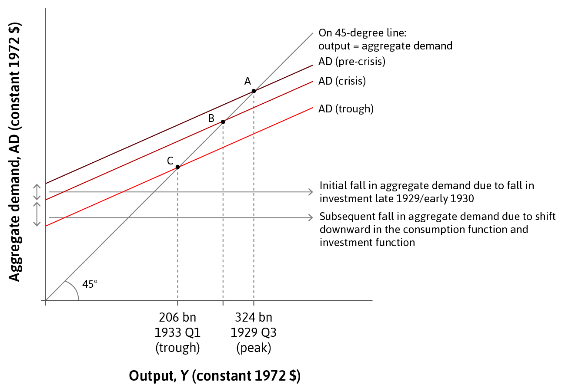
The Great Depression
A: goods market equilibrium (1929)
B : fall in investment = downward shift of AD
C: fall in autonomous consumption = further downward shift of AD
  uncertainty due to stock market crash, pessimism, banking crisis and collapse of credit

Slide 23
Fiscal Policy
04.
The role of Government

Slide 24
Model 2
Model 2a.
Aggregate Demand = C + I + G
Government Spending is exogenous
Also affects C via taxes.
Model 2
AD = C + I + G + X – M
Exports (X) is exogenous to model
Imports (M) depend on domestic market
We make the model more realistic by adding Government and External Sector

Slide 25
The Extended Multiplier model
Saving, taxation and imports are referred to as leakages from the circular flow of income. They reduce the size of the multiplier.
some household income goes directly to the government as taxes
… and some income is used to buy goods abroad
Smaller multiplier implies a flatter AD curve.
AD = c₀ + c₁(1 - t)Y + I + G + X - mY

Slide 26
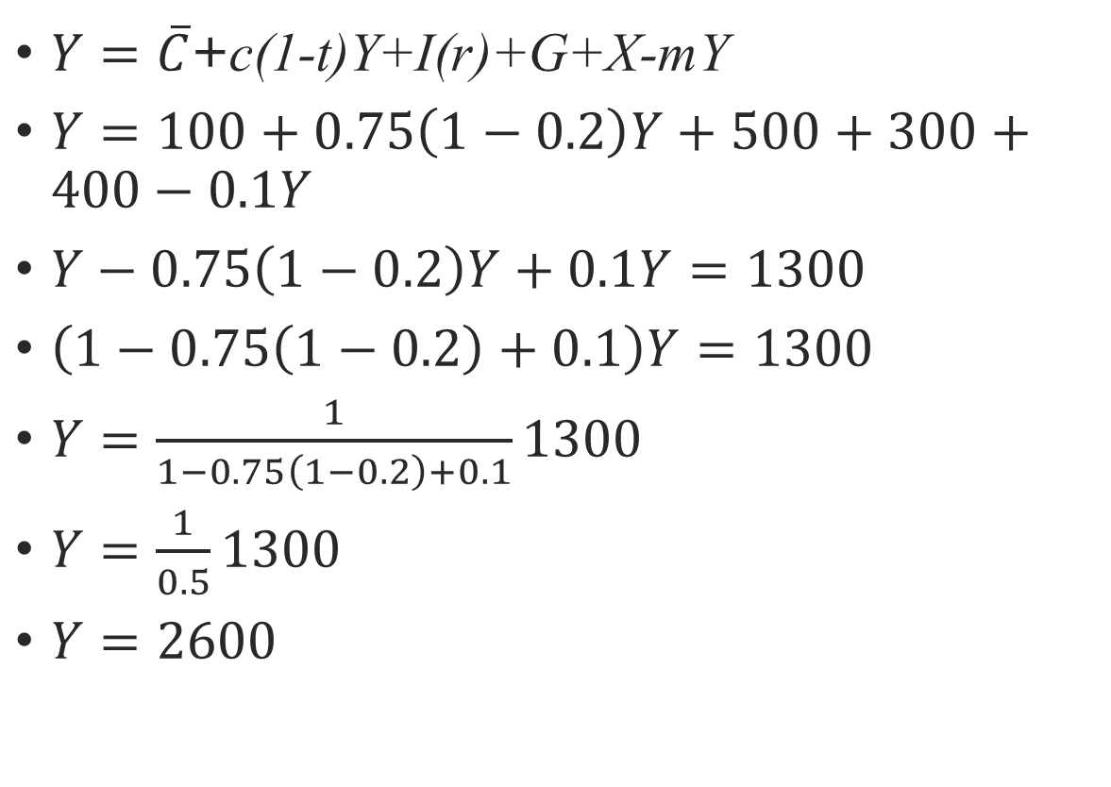
Numerical Example
$Y=\overline{C}$+c(1-t)Y+I(r)+G+X-mY
$Y=100+0.75\left(1−0.2\right)Y+500+300+400−0.1Y$
$Y−0.75\left(1−0.2\right)Y+0.1Y=1300$
$\left(1−0.75\left(1−0.2\right)+0.1\right)Y=1300$
$Y=\frac{1}{1−0.75\left(1−0.2\right)+0.1}1300$
$Y=\frac{1}{0.5}1300$
$Y=2600$
A useful approach is to identify the multiplier and the sum of the exogenous spending.

Slide 27
Stabilising the Economy
Government spending is large and exogenous
Higher tax rates lower the multiplier
Unemployment benefits helps household consumption smoothing
Deliberate interventions via fiscal policy.
E.g. NZ ‘Shovel Ready’ projects as part of Covid19 recovery.
There are 4 ways the Government can stabilise economic fluctuations

Slide 28
NZ Covid19 shock
GDP Statistic | June Quarter 2019 | June Quarter 2020
GDP | $78,384m | $73,315m
Consumption | $44,694m | $40,767m
Investment
Fixed Assets | $13,131m | $10,482m
Residential Buildings | $5,771m | $4,634m
Inventories | -$1,891m | -$2,879m
Government Spending | $15,288m | $16,762m
Exports | $22,462m | $19,328m
Imports | $21,071m | $15,979m
GDP in 2020 shrank 6.4% compared to June Quarter 2019.

Slide 29
NZ Covid19 shock
GDP Statistic | June Quarter 2019 | June Quarter 2020
GDP | $78,384m | $73,315m
Consumption | $44,694m | $40,767m
Investment
Fixed Assets | $13,131m | $10,482m
Residential Buildings | $5,771m | $4,634m
Inventories | -$1,891m | -$2,879m
Government Spending | $15,288m | $16,762m
Exports | $22,462m | $19,328m
Imports | $21,071m | $15,979m
Investment fell by 28.1%
Consumption by 8.8%
Government spending rose by 9.6%
Net Exports rose by 140.8%.

Slide 30
Why changes?
Consumer spending on travel and durables dropped because of lockdown.
Exports fell because overseas tourists could not visit.
Imports fell by more (durables like cars and oil imports dropped)
Government increased spending on:
Medical goods and services (tests)
Quarantine facilities (booked and converted Hotels)
Computers for children in low-income households

Slide 31
Consumption smoothing
Wage Subsidy
  Did not wait for workers to lose jobs
  Employers were provided a wage subsidy (80% of wage levels)
  This meant firms kept workers employed even though there was (usually) no work for them.
  With workers still receiving wages, they could ‘smooth’ consumption even when they were not working.

Slide 32
Automatic Stabilisers
Unemployment benefits offset a contraction in the economy
Progressive (proportional) tax rates offset an expansion in the economy
Some stabilisation occurs automatically without deliberate policy.

Slide 33
The paradox of thrift
In a recession, many households face a budget deficit
In the economy as a whole, spending and earning go together.
The paradox of thrift: the aggregate attempt to increase savings leads to a fall in aggregate income.
Worries about their falling wealth leads to spending cuts and more savings
Spending less leads to a worsening recession
Households could worsen a recession.
Fallacy of composition: what is true for one part of the economy (a single household) is not true of the whole economy.

Slide 34
Fiscal stimulus
Fiscal stimulus:
Tax cuts to encourage the private sector to spend more, and/or
Spending increases (G), which directly increases AD
The rise in G operates via the multiplier, so the increase in Y will typically be greater than the increase in G.
A fall in AD can be offset by an expansionary fiscal policy

Slide 35
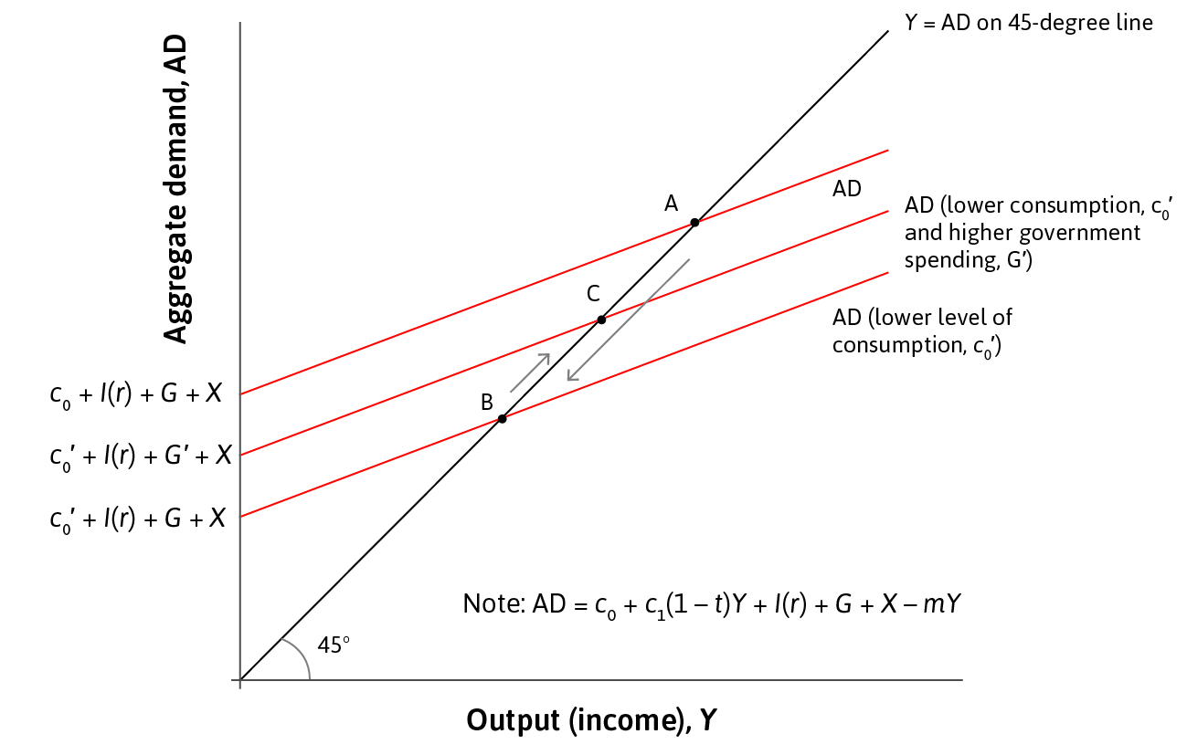
Fiscal stimulus
Suppose autonomous consumption falls.
Economy moves from A to B

Slide 36
Fiscal stimulus
Government than increases its spending from G to G’
Economy moves from B to C
Recession is smaller or shorter

Slide 37
Financing fiscal stimulus
Fiscal stimulus (↑G or ↓T) will result in a negative budget balance (government budget deficit).
If it is not reversed after the recession, it will increase government debt.
A government budget surplus is when tax revenue is greater than government spending.
The budget balance is T -G

Slide 38
Austerity policy
Austerity policy can reinforce (or worsen) rather than remedy a recession by further reducing aggregate demand.
Governments may be forced into this policy if they are unable to borrow to finance their deficits.
Occurs when Governments are committed to balanced budgets.

Slide 39
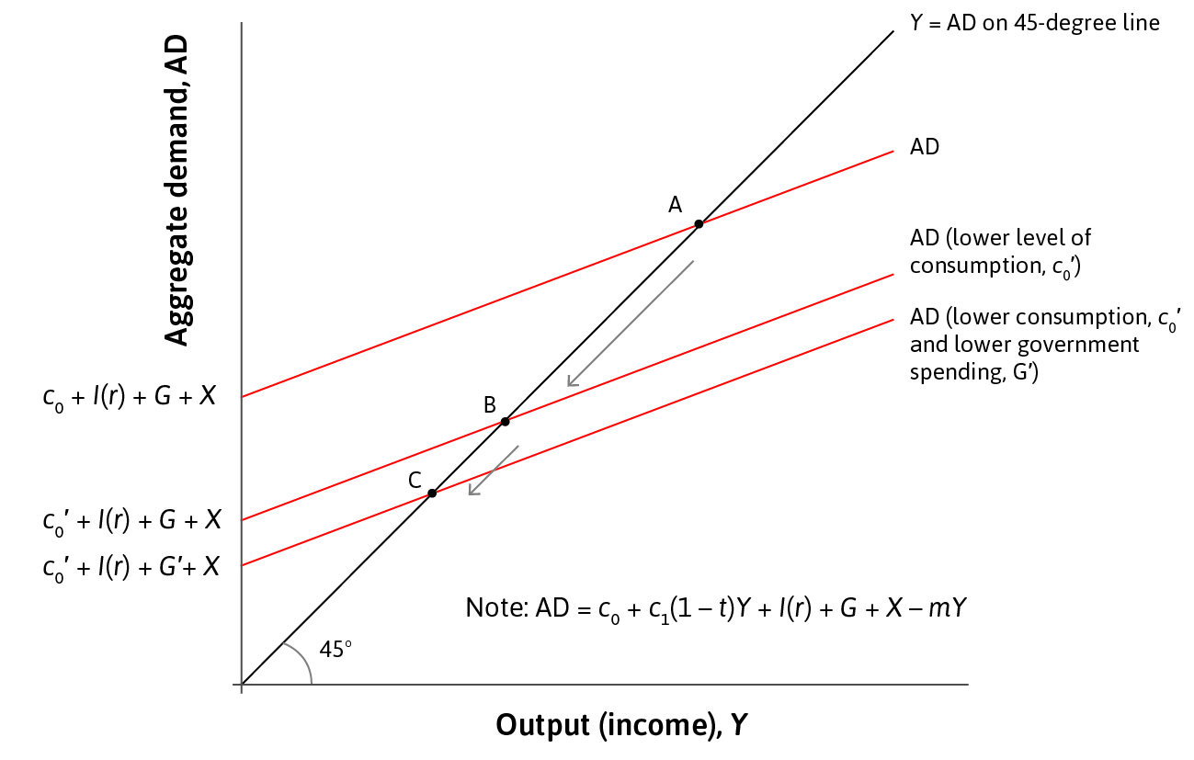
Austerity policy
Economy experiences a decline in autonomous consumption
AD curve shifts down
Economy moves from A to B
Recession occurs

Slide 40
Austerity policy
Government receives less tax revenue
They are in deficit
To balance their budget (T=G) Government spending must fall
The recession is made worse

Slide 41
The multiplier in practice
In reality, it also depends on:
Rate of capacity utilisation (the phase of the business cycle):
with fully employed resources, an increase in government spending would crowd out private spending
Leading to a smaller multiplier effect
Expectations of the private sector:
the multiplier could be negative if rising fiscal deficit erodes consumer confidence
In our simple model, the multiplier depended only on
  MPC - c
  MPM – m
  Tax rate - t

Slide 42
Crowding Out
The multiplier assumes Government spending does not change spending by firms and households
Crowding out is when it does change spending.
  E.g. firms cannot borrow for their projects because funds have been lent to Government instead. Interest rates could rise.
  Some scare inputs (e.g. engineering experts, builders) get employed by Government instead.

Slide 43
Consumer Confidence
Consumers may also respond to rising deficits and debt.
  If they feel less confident they may cut back spending as a precaution.
  They may save more in the expectation future taxes will rise.
  Increased savings reduces consumption and multiplier

Slide 44
The Government’s Finances
Primary budget deficit = G –T
  procyclical
  the government must borrow to cover the gap between spending and revenue, by issuing bonds
Government debt = sum of all the bonds sold over time to finance budget deficit – matured bonds (repaid debt).
Sovereign debt crisis = a situation in which government bonds come to be considered risky (default risk).
The deficit excluding interest payments is called the primary budget deficit.

Slide 45
Government debt
Payments on debt mean less can be spent on other items.
However, there is no point at which the government has to pay off all its stock of debt—it can roll it over instead by issuing new bonds.
An ever-increasing debt ratio is unsustainable, but there is no rule that says exactly how much debt is problematic.
A large stock of debt relative to GDP can be a problem because the government has to pay interest on its debt

Slide 46
NZ Debt
Item | 1980 | 1984 | 1989 | 1991
Health | $1,136m | $1,805m | $2,639m | $3,998m
Education | $1,009m | $1,674m | $3,569m | $4,459m
Social Service | $2,715m | $4,049m | $9,123m | $11,126m
Debt Servicing | $771m | $2,240m | $2,210m | $954m
GDP deflator (1978=100) | 128.8 | 251.0 | 382.0 | 427.3
In the 1970s and 80s debt levels in NZ rose.
Public debt peaked at 71% of GDP in 1985.
Data is in nominal terms

Slide 47
Think Big
“Think Big” was a series of capital-intensive, big energy projects.
They required significant borrowing from overseas.
Their construction led to crowding-out effects
They only had a positive return if oil prices kept rising (>USD$50 per barrel)
Oil prices fell (reached USD12 per barrel in 1985)
Government Debt rose because of high, annual and large budgets deficits (7% of GDP)
Think Big added $7bn to debt

Slide 48
Factors
Factors that affect the sustainability of debt include:
  The level (% of GDP)
  The mix (foreign vs domestic)
  Repayment schedule (long term vs short term)
  Export sector (ability to earn foreign exchange)
  Capital flight

Slide 49
Debt-to-GDP ratio
Indebtedness can fall
  if the primary budget balance is positive
  if GDP is growing faster than government debt
  if inflation is high (real value of debt falls)
  Revenue from asset sales is used to pay down debt.
The level of indebtedness of a government is measured relative to the size of the economy (debt-to-GDP ratio).

Slide 50
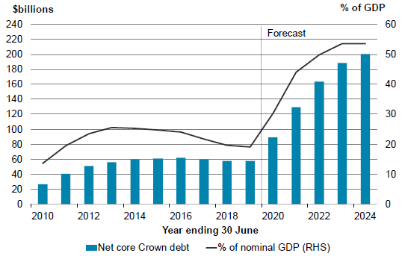
NZ Public Debt
Since mid-90s Governments have set debt targets.
Before 2020 Pandemic, target was Net Public Debt at 20% or less of GDP

Slide 51
The sinews of war are infinite money
Cicero 106CE -43BCE

Slide 52
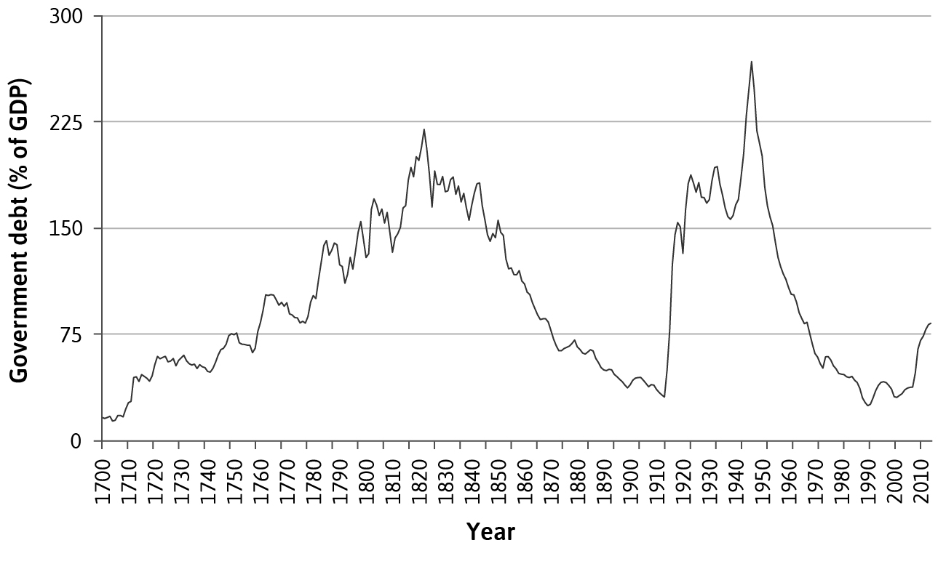
UK Debt-to-GDP ratio

Slide 53
Wars
Governments (typically) have to borrow to fund wars
Tax revenue falls
  Workers become combatants
  Farms and factories may be destroyed
Post-War booms can be illusory
  Consumption rises as rationing ends and civilian production increases
  Household incomes rise as Government debt repaid
  Rebuilding increases investment
  Looks good only because normal economic activity was suppressed
Wars increase public debt

Slide 54
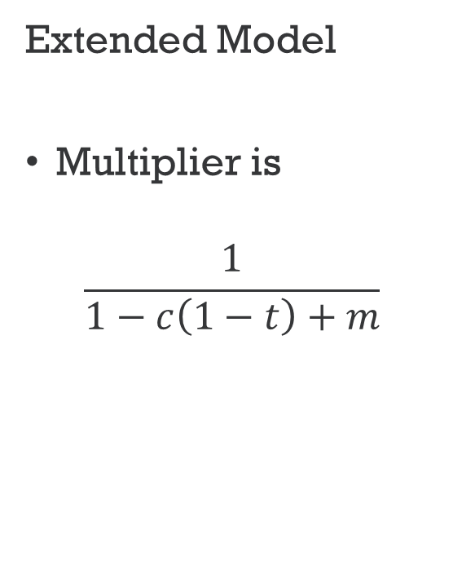

Summary- Multipliers
Simple Model
Multiplier is
$$\frac{1}{1−c}$$
Extended Model
Multiplier is
$$\frac{1}{1−c\left(1−t\right)+m}$$

Slide 55

Any questions?

